Slide 1
ELLS Summer School: Practical Introduction to Programming with Python
Computer Networks and Communication
Marvin Anker, M.Sc

Slide 2
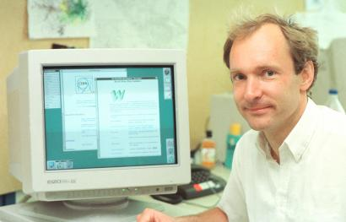
Game Changer: World Wide Web (30 years ago)
Started as project at CERN
Tim Berners-Lee developed
the markup language HTML (linked data!),
the transfer protocol HTTP,
the concept of URLs,
the first browser called WorldWideWeb and
the web server CERN httpd
Move from isolated towards connected applications
https://qz.com/1568970/tim-berners-lee-on-founding-the-world-wide-web-30-years-ago/

Slide 3
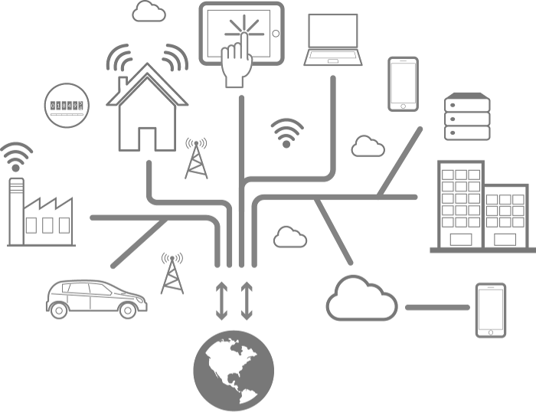
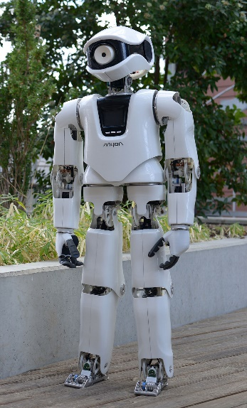
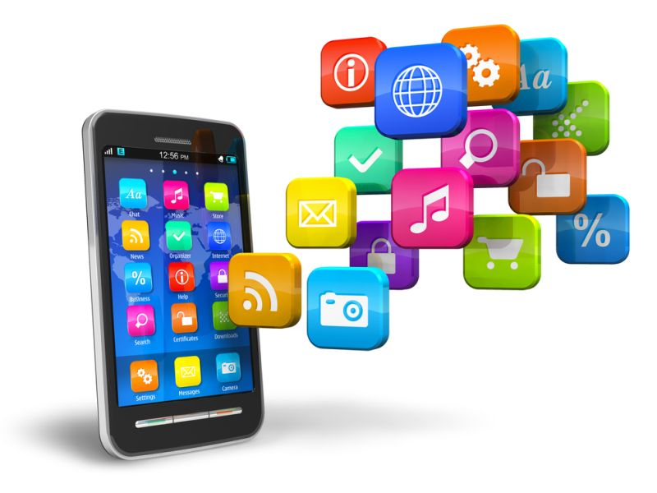
Dynamic Environments Example: Internet-of-Things / Cyber-physical Systems
New requirements for computer networks
Heterogeneous devices
Mobile devices

Slide 4
Content
This presentation covers…
1. Computer Networks in a Nutshell
2. Use Case: The Internet
3. Communication Paradigms
4. Application Programming Interface (API)
Learning Goals:
You will learn how a set of heterogeneous devices can communicate.
You will learn how the Internet works.
You will learn how API’s work and how they can be utilized.

Slide 5
http://www.ghcomputernetworks.com/
1. Computer Networks in a Nutshell

Slide 6
Distributed Systems: Definition
Definition 1 (Lamport):
“A distributed system is a system in which I cannot get any work done because some machine that I have never heard of has crashed.”
Definition 2 (Tanenbaum, van Renesse):
“A distributed system is a collection of independent computers that appear to the users of the system as a single computer.”
Definition 3 (Coulouris, Dollimore, Kindberg):
“A distributed system consists of a collection of autonomous computers linked by a computer network and equipped with distributed system software”

Slide 7
Distributed Applications: Model
interaction
host
application part
interaction
Network (e.g. Intranet, Internet)
host
host
application part
application part
interaction
interaction
host
application part
Single points of failure
No global view, no global time
Heterogeneous
interaction

Slide 8






Components of Distributed Systems
Nodes: hosts | Computer systems Different operating systems (Unix, Windows, …) Different hardware and resources (RAM, storage, CPU, ...)
Edges: computer network | Protocols (TCP/IP, UDP/IP, LoRaWAN, …) Media (IEEE 802.11 (Wifi), Bluetooth, Ethernet, …)

Slide 9
Client-Server Model
Asynchronous, non-blocking requests are possible
Client:
Sends service request to the server
Server:
Waits for request, processes it, and sends the result back to the client
Server might communicate with other servers to fulfill a request
Client
Server
process
blocked
send service
request
wait for
result
process
request
send result for request
Examples:
www, search engines, software-as-a-service, directory service (DNS), …
time

Slide 10
Layers, Protocols and Interfaces
Layered systems: Every layer realizes one level of abstraction
Interface:
Defines which service primitives the lower level offers to the higher level
Protocol:
Communication agreement between two parties of the same layers on different machines
Layer k+1
Layer k+1 protocol
Layer k+1
Layer k/k+1
interface
Layer k
Layer k protocol
Layer k
Layer k-1/k
interface
…
…
Layer 1/2
interface
Layer 1
Layer 1 protocol
Layer 1
Physical medium

Slide 11
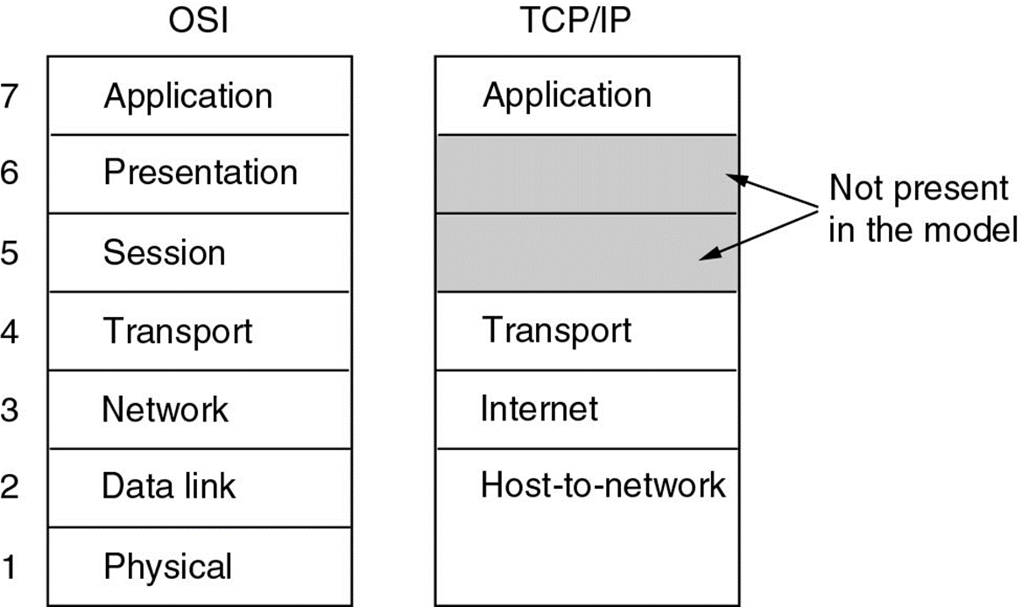
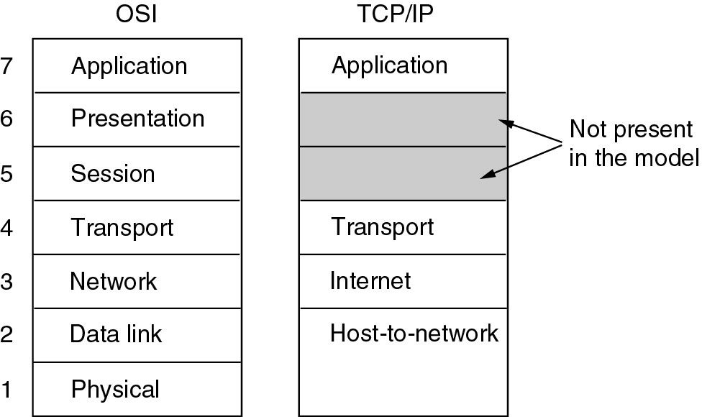
The TCP/IP Model (also called Internet Model)
TCP/IP stack does not care about the physical medium, as long as it provides a way to communicate octets
Notes:
Host to network: Is responsible for the physical transmission of data over a network. It handles hardware addressing (Using MAC addresses to ensure data is sent to the correct device..) Protocol: Ethernet/Wifi
Internet: This layer is responsible for logical addressing, routing, and packaging data into packets. It ensures data can travel across different networks and reach its destination. Protocol: IP-Adress
Transport: ensures reliable data transfer between two endpoints. It is responsible for error recovery, flow control, and ensuring that data arrives in order. Protocol:TCP/UDP
Application: provides protocols and services for end-user applications. It supports application processes and provides network services directly to users. Protocol: HTTP

Slide 12
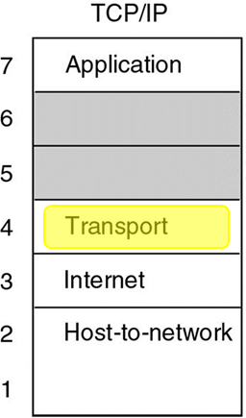
Transport Protocols for the Internet
User Datagram Protocol (UDP) [Connectionless] | Transmission Control Protocol (TCP) [Connection-oriented]
Unreliable: Messages might get lost No flow control, error control, and retransmission Not ordered: Sending order may not be equal to receipt order Lightweight: No connection tracking, no message ordering etc. Datagrams: Packets are sent as one single piece | Reliable: Certainty that the message will arrive at the destination Acknowledgements, retransmissions Flow control, congestion control Ordered: Sending order is always equal to receipt order Overhead: Message tracking, ordering information, state Streams: Data is read from a stream which might hold several packets (called segments) – looks like a file
User Datagram Protocol (UDP) [Connectionless]
Unreliable: Messages might get lost No flow control, error control, and retransmission Not ordered: Sending order may not be equal to receipt order Lightweight: No connection tracking, no message ordering etc. Datagrams: Packets are sent as one single piece
User Datagram Protocol (UDP) [Connectionless] | Transmission Control Protocol (TCP) [Connection-oriented]

Slide 13
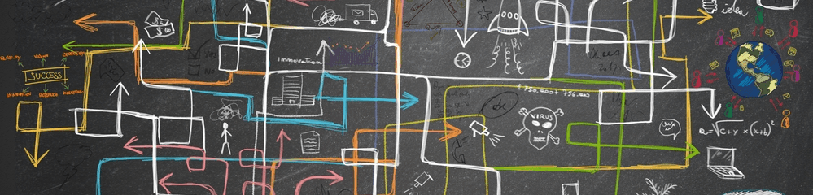
https://techolution.com/complex-adaptive-systems/
2. Use Case: The Internet

Slide 14
Internet Usage
Traditional applications (1970 – 1990):
E-mail (Sendmail)
News (NNTP)
Remote login (Telnet)
File transfer (FTP)
Today:
Web pages (HTTP + HTML)
File transfer (FTP)
Sending emails (SMTP)
Receiving emails (POP3, IMAP)
Smartphone apps (specific protocols, HTTP)
Video streaming or video calls (specific protocols using UDP/TCP)
Machine-to-machine communication (e.g., MQTT, OPC UA, …)

Slide 15
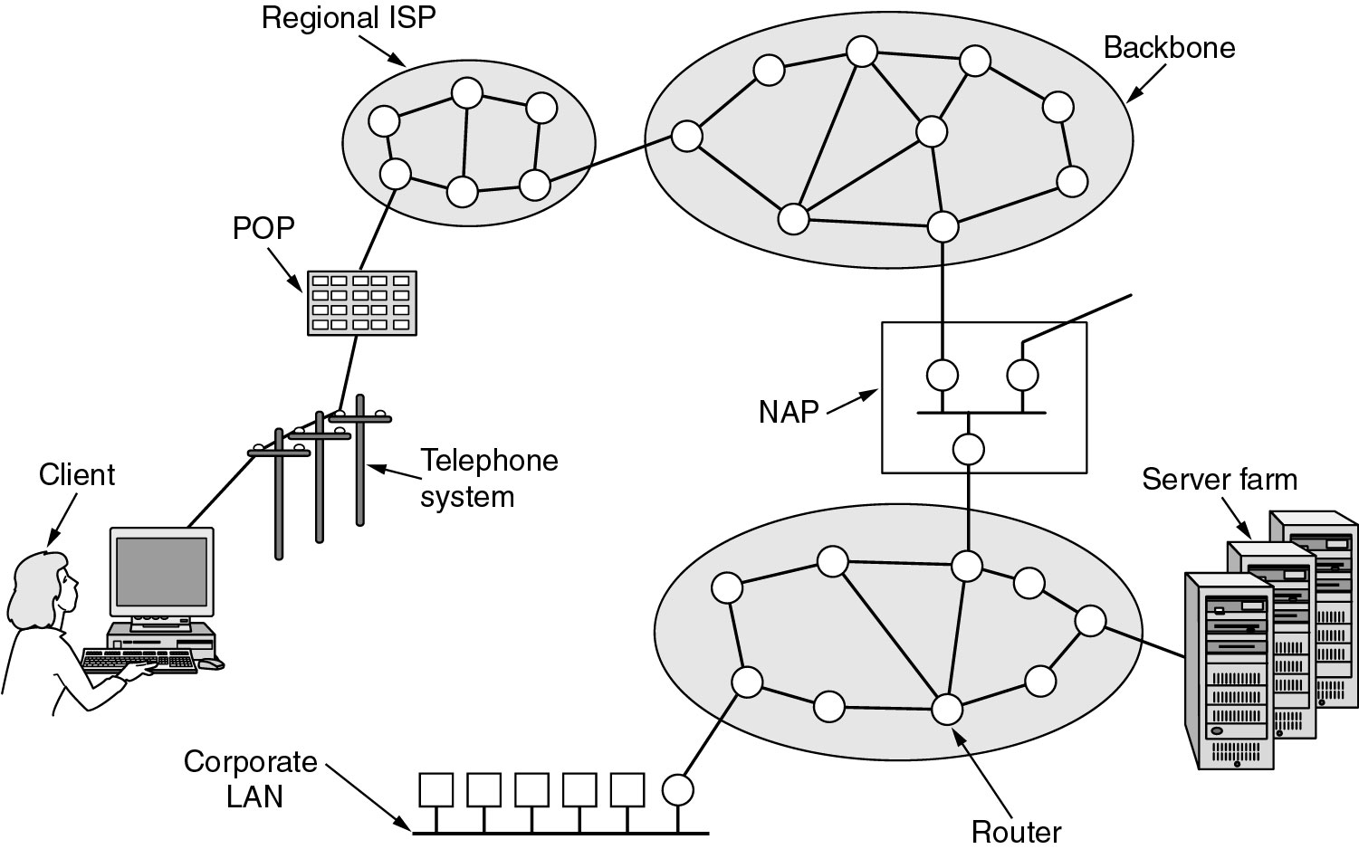
Architecture of the Internet
Legend:
POP - Point of Presence
NAP - Network Access Point
ISP - Internet Service Provider LAN - Local Area Network

Slide 16
Sockets
TCP and UDP both use the port concept (indirect addressing)
Port is the point of delivery for the transport layer
A process (i.e., the program) is identified by a number (0-65535) and the type (TCP or UDP)
Sockets connect applications and the protocol software
Those are an API between application and protocol stack
Process/
Application
TCP/
IP
TCP/
IP
Process/
Application
API = Application Programming Interface

Slide 17




Many Applications, one Wire(less) Connection
Typically many applications (potentially in the background) use the network connection simultaneously
How is this possible? → Using different sockets and IP addresses
Ports: 143, 993 (IMAP);
443, 587, 465 (SMTP)
IP: 144.41.4.28
(mailserv.uni-hohenheim.de)
Ports: 80 (HTTP),
443 (HTTPS)
IP: 144.41.103.120
(ilias.uni-hohenheim.de)
E-Mail
Browser
Ports: 8801, 8802
IP: 3.235.73.0
Port: 4070
IP: 78.31.8.0

Slide 18
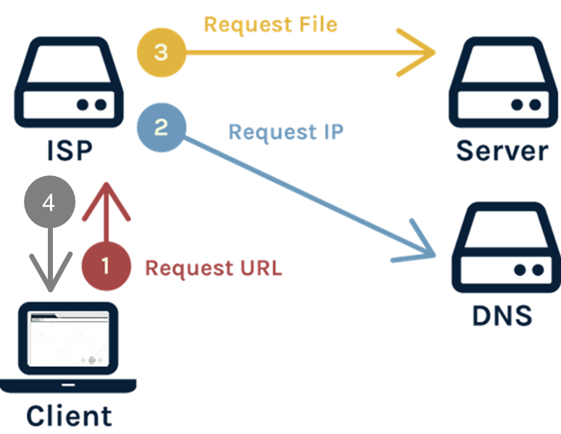
How to load a Webpage?
High-level View:
Client sends the URL through the network to the Internet Service Provider (ISP)
ISP resolves the URL using a Domain Name System lookup → receives IP of the server
Requests the web page from the server and sends it to the client
ISP returns the web page content to the client’s browser

Slide 19

Hyper Text Transfer Protocol (HTTP)
The communication between client and web server uses the Hyper Text Transfer Protocol (HTTP)
Protocol (HTTP/1.1):
TCP connection may be left open during communication between server and client
Multiple hosts per server
host is specified in requests
Web Client
(Browser)
Connect
Web Server
Request
Response
…
Request
Response
Close
Legend:
TCP HTTP

Slide 20
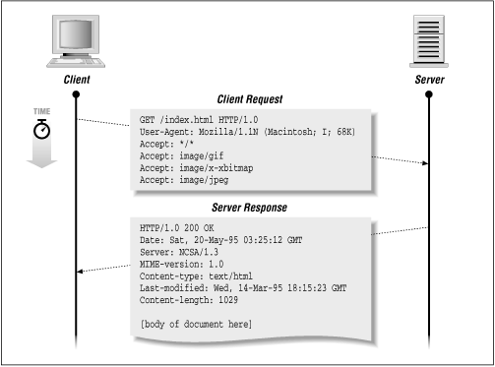
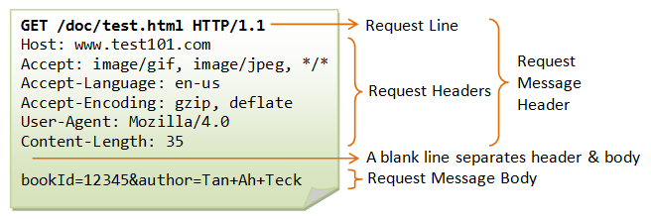
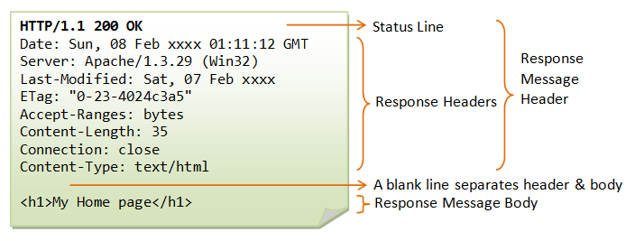
HTTP Request/Response Example
https://www.oreilly.com/openbook/webclient/wcp_0302.gif, https://documentation.help/DogeTool-HTTP-Requests-vt/http_request.htm

Slide 21

https://cyber.olympiadsuccess.com/class-9-networking
3. Communication Paradigms

Slide 22
Client-Server Model
Client:
Sends service request to the server
Server:
Waits for request, processes it, and sends the result back to the client
Server might communicate with other servers to fulfill a request
Client
Server
process
blocked
send service
request
How to communicate with several
instances simultaneously?
wait for
result
process
request
send result for request
Examples:
www, search engines, software-as-a-service, directory service (DNS), …
time

Slide 23
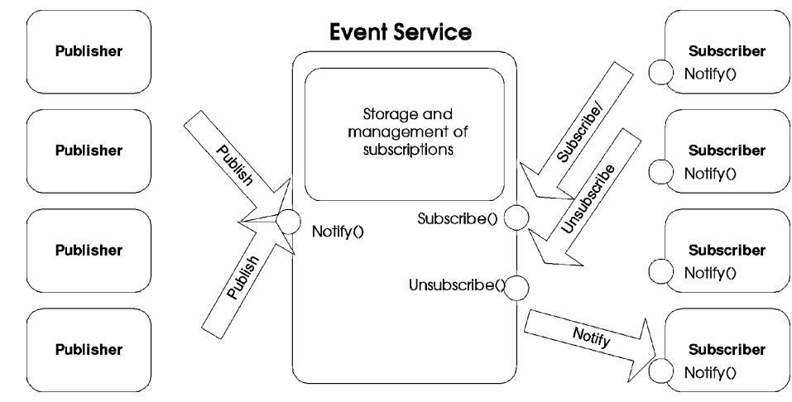
Publish/Subscribe (Pub/Sub)
Two Roles:
Producers publish notifications for topics
Consumers subscribe to topics
Notification service (NS):
delivers notifications using the topics
Characteristics of Pub/Sub:
Asynchronous communication (initiated by the producer)
Indirect Addressing (anonymous)
Loose coupling
[Eugster et al. ,2003]

Slide 24
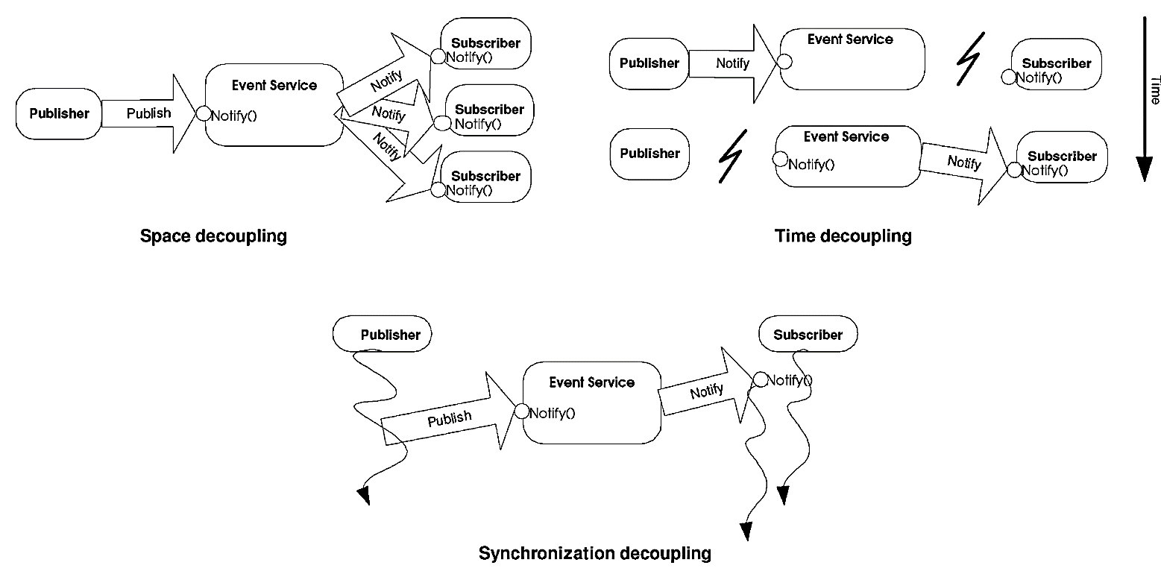
Decoupling through Pub/Sub
[Eugster et al. ,2003]
Notes:
Synchronisation: Asynchronous Communication: Publishers can send messages without waiting for subscribers to receive them, and subscribers can process messages independently of when they are published.
Space: Topic-Based: Publishers send messages to a topic or channel, and subscribers listen to topics or channels of interest. Neither party needs to know who the other is or where they are located.
Time: publisher and subscriber do not need to be active at the same time for the message to be delivered. This is usually achieved through intermediaries like message brokers or queues.

Slide 25
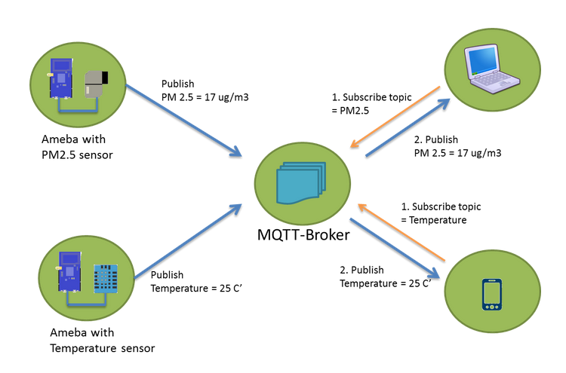
MQTT Example

Slide 26
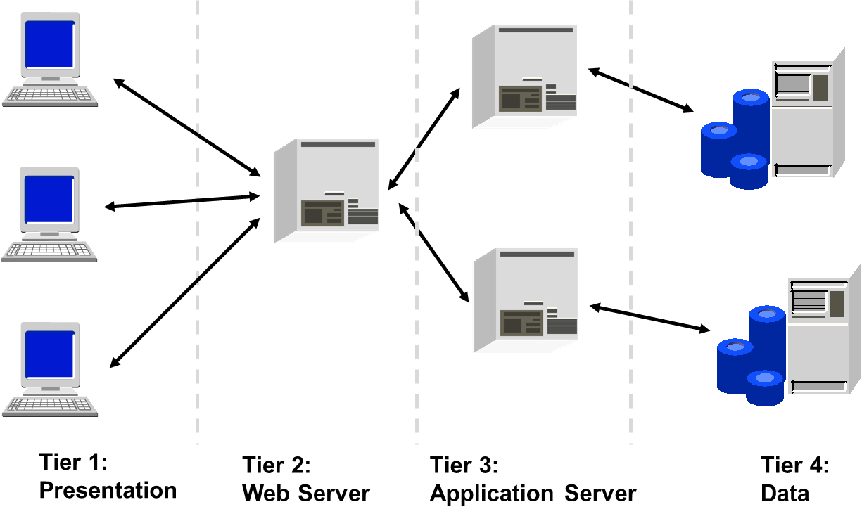
N-Tier Architectures
Nowadays, distributed applications are often developed as N-Tier applications (N = 2, 3, 4)
Every „tier“ (not layer) performs a task
Example - Web application:

Slide 27

https://securityintelligence.com/
4. Application Programming Interface (API)

Slide 28
Where does the Data come from? Application Programming Interfaces (API)
An Application Programming Interface (API) is a set of commands, functions, or protocols that enable interaction with an external system
APIs provide developers with standard commands for performing common operations
APIs thus allow applications to communicate with each other → provides interoperability
An API is not the database or even the server, but the code that governs the access points for the server and enables communication
APIs allow access and (potentially) manipulation of web resources

Slide 29

General Concept of APIs
APIs are
Software that allow other applications to access their data or services
Instructions that enable the interaction
Sets of rules that describe how one application can interact with another
API-request to gain information
Client
Server API-answer combined with requested information
Server
Enables data transmission
Contains terms of data exchange
Notes:
Client: Software/User

Slide 30

API Definitions
There are various definitions from different viewpoints – example:
APIs facilitate pragmatic reuse and improve the productivity of software development (Niu et al. 2016)
Client-server request-response communication:
Web app
Web server
Database
Internet
API
•••
</>
Notes:
APIs are defined from various perspectives: concrete definition and descriptions of APIs by their attributes or characteristics.
→ One approach is to use a technical definition while considering also perspectives of users and practitioners
APIs can be described as collections of standardised technical specifications and routines that allow developers to engage productively with databases and platforms.

Slide 31
Types of APIs – Use Case
Web API
Most common API class
Provides functionality transfer and machine-readable data between web-based systems in a client-server model
Mainly uses Hypertext Transfer Protocol (HTTP) to deliver requests from web applications and responses from servers
Can be used to extend app or site functionalities, e.g., Google Maps API to add a map to a website
Notes:
Other example: Pinterest API to add users’ Pinterest data to a website

Slide 32
API calls
API calls are specific requests to a software to perform particular actions/ access its functionality, e.g., retrieving or create data
Required syntax is described in documentation
Requests and responses vary depending on the web API type
The destination of that request is an API endpoint, which is a specific URL
API calls use HTTP methods like GET, POST, PUT, DELETE, etc.
Notes:
Each API contains and is implemented by function calls – language statements that request software to perform particular actions and services
The URL endpoint specifies the resource being accessed or modified, headers for additional information like authentication tokens, and sometimes a request body with data to be sent.
These methods correspond to different actions such as retrieving data (GET), submitting data (POST), updating data (PUT), or deleting data (DELETE).

Slide 33
Summary
Distributed Systems
A collection of independent computers that appear as a single coherent system to users.
Components:
Nodes: Various computer systems with different OS and hardware.
Edges: Network protocols (e.g., TCP/IP) and media (e.g., Wi-Fi, Ethernet).
HTTP (Hypertext Transfer Protocol)
Foundation of data exchange on the Web, enabling client-server communication.
API (Application Programming Interface)
A set of commands, functions, or protocols for interacting with an external system.
Standardize the way components interact and exchange data.
Allow for interoperability and integration of various services and applications.
Notes:
This presentation provided a comprehensive overview of how distributed systems function, the role of HTTP in client-server communication, and the critical role of APIs in enabling interaction across diverse systems.

Slide 34
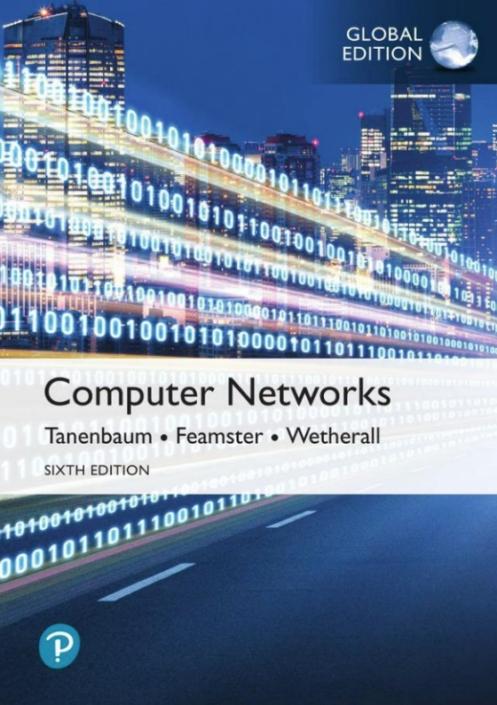
Further Reading
A. Tanenbaum, N. Feamster, and D. Wetherall: Computer Networks. Pearson, 6th edition, 2021.
5th edition is online available at: https://csc-knu.github.io/sys-prog/books/Andrew%20S.%20Tanenbaum%20-%20Computer%20Networks.pdf

Slide 35
Parts of the slides are taken from Christian Becker‘s lecture on Self-organizing Systems (University of Mannheim).

